Slide 1



Capstone Project NYC taxi trip time Prediction
Supervised Learning Regression

Slide 2


TEAM PRESENTATION
Vinayak Marathe
Riya Patel
Muskan Kasare

Slide 3
ROADMAP
Introduction, Problem Statement & Understanding the Data
Hypothesis Testing & Feature Engineering
Competitive Advantage & Future Work
1
3
5
2
4
6
Data Wrangling , Data Manipulation & Data Visulization
Data Pre-Processing & Model Implementaion
Conclusion

Slide 4
Introduction
1
Information about NYC taxi trips

Slide 5
INTRODUCTION
The NYC taxi trip time prediction project involves building a machine learning model to predict the time it takes for a taxi to travel from one location to another in New York City. The model takes into account various factors such as traffic conditions, weather, time of day, and origin-destination pairs to make its predictions. To build the model, a large dataset of historical taxi trip records is used to train the model. This dataset includes information such as pickup and drop-off locations, time of day, and trip duration. Various machine learning algorithms, such as regression and decision trees, can be applied to the data to build a predictive model. Once the model is trained, it can be used to predict the trip time for new, unseen taxi trips in NYC. This information can be useful for taxi drivers and passengers, as well as for transportation planning and optimization. The results of the project can also be used to understand the factors that influence taxi trip times in NYC, such as traffic patterns, weather conditions, and time of day. This information can be used to make improvements to the city's transportation infrastructure and to develop more efficient transportation systems.

Slide 6
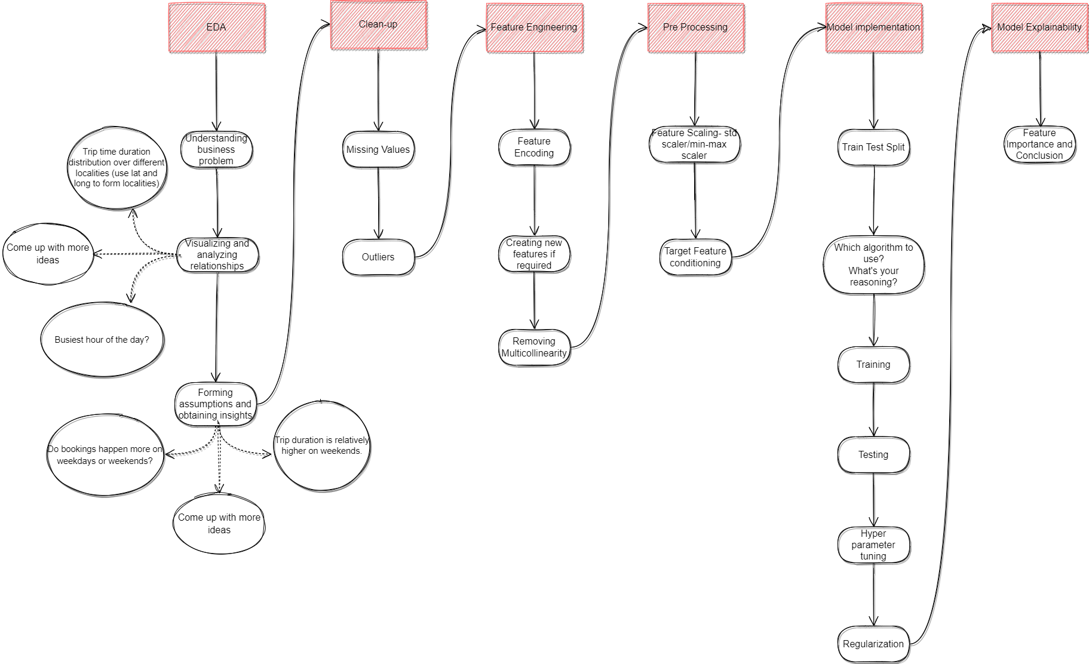
Project Architecture

Slide 7
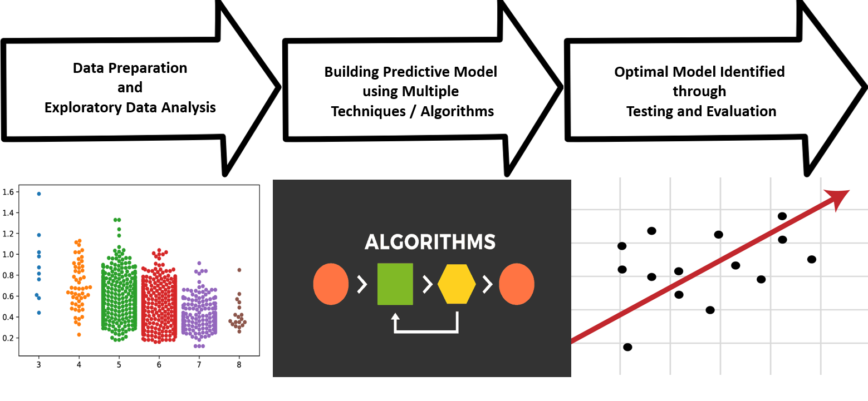
Approach

Slide 8
Problem Statement
2
How we predict the target variable

Slide 9
BUSINESS PROBLEM OVERVIEW
The problem statement for the NYC taxi trip time prediction project is to accurately predict the time it takes for a taxi to travel from one location to another in New York City. The objective is to develop a machine learning model that takes into account various factors such as time of day, and origin-destination pairs to make its predictions.
The challenge lies in capturing the complex relationships between the various factors that influence taxi trip times and accurately predicting the trip duration for any given trip.
The solution to this problem will have practical applications for taxi drivers and passengers, as well as for transportation planning and optimization. Accurate taxi trip time predictions can help drivers plan their routes more effectively and reduce the time and cost of travel for passengers. It can also be used to improve the city's transportation infrastructure and to develop more efficient transportation systems.

Slide 10
Understanding Data
3
What are the feature and labels in our data

Slide 11
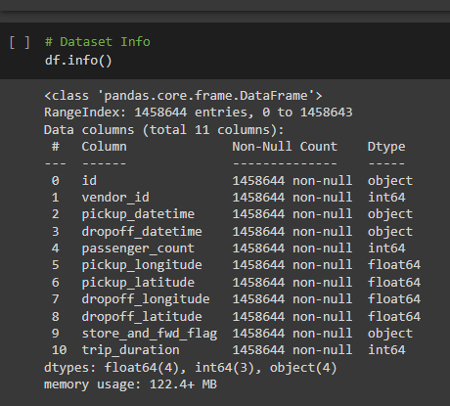
Understanding Data
In our dataset of NYC taxi trip time prediction, there are 1458644 rows and
11 columns with zero null values and zero duplicate value

Slide 12
Understanding Variables
Continuous numerical: id, pickuplongitude, pickuplatitude, dropofflongitude, dropofflatitude, trip_duration
Discrete numerical: vendorid, passenger_count, pickup_datetime_hour, dropoff_datetime_hour
Datetime: pickupdatetime, dropoffdatetime
Nominal categorical: store_and_fwd_flag, pickup_datetime_day, pickup_datetime_month, dropoff_datetime_day, dropoff_datetime_month

Slide 13
Variables Description
Fields | Description
id | A unique identifier for each trip
vendor_id | A code indicating the provider associated with the trip rec
pickup datetime | date and time when the meter was engaged
dropoff datetime | date and time when the meter was disengaged
passenger_count | the number of passengers in the vehicle (driver entered value)
pickup latitude | the latitude where the meter was engaged
dropoff longitude | the longitude where the meter was disengaged
dropoff latitude | the latitude where the meter was disengaged
store and fwd flag | This flag indicates whether the trip record was held in vehicle memory before sending to the vendor because the vehicle did not have a connection to the server: Y - store and forward, N - not a store and forward trip
trip duration | duration of the trip in seconds

Slide 14
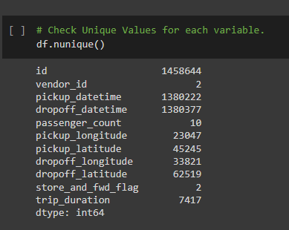
Unique Values in our Variables

Slide 15
Python Libraries Used in this project
Numpy – Python library used for scientific computing
Pandas – Python library used for data manipulation
Matplotlib.pyplot – Python library used for data visualization and graphical plotting
Seaborn – Python library used for statistical graphics plotting (visualization)
Folium – Python library used for interactive maps of different types and locations
Sklearn – Scikit-learn (Sklearn) is the most useful and robust library for machine learning in Python.

Slide 16
Data Wrangling (EDA)
4
Finding meaningful insights

Slide 17
Overall Insights
There are only 2 vendors , vendor 1 and 2, vendor 2 has 780302 while vendor 1 has 678342 trip respectively
10 unique number of passenger count. with passenger count 1 has most trips 1033540
There are 1450599 times trip data Store and forwarded and 8045 time trip data not stored and forwarded
we convert the datatype of pickup_datetime and drop-off datetime from object to datetime
Also we mapped the stored and forwarded flag from Y/N to 1/0 which is now converted into int64 i.e. numeric data that we require further
Our dependent variable is trip duration
We introduce a new column say trip distance which will give us the distance covered during a trip
Longest trip distance in km is 1240.91 km

Slide 18
Overall Insights
7935 trips where distance covered by taxi is 0.00 km
240459 trips where distance covered by taxi is between zero and 1 km
450488 trips where distance covered by taxi is between 1 and 2 km
497469 trips where distance covered by taxi is between 2 and 5 km
262293 trips where distance covered by taxi is greater 5 km
We introduce a new column say Average speed of a journey in kmph
In peak hours (between 6 to 10 pm) traffic/ trips are 77.18% more than off peak hours (between 2 am to 6 am)
Busiest hour in a day is between 6 to 7 pm

Slide 19
Overall Insights
The busiest day for taxi trips is: 2016-04-09 i.e. 9th April 2016 The number of trips on that day is: 9796
The number of trips on busiest day in peak_hour is 2095
The PEAK hours is between 6 pm to 10 pm where on an average 1918 number of ongoing trips per day in Network City
The OFF-PEAK hours is between 2 to 6 am where on an average 438 number of ongoing trips per day in New York City
during peak hours trips are 67 % less on weekends as compare to weekdays
during off-peak hours trips are 12 % more on weekends as compare to weekdays
Average trip duration during weekdays :16 minutes 12 seconds
Average trip duration during weekends :15 minutes 26 seconds
Average speed during weekdays :13.87 kmph
Average speed during weekends :15.81 kmph

Slide 20
Data Visualization & Business Insights
5
Data Visualization using different charts & find meaningful insights

Slide 21
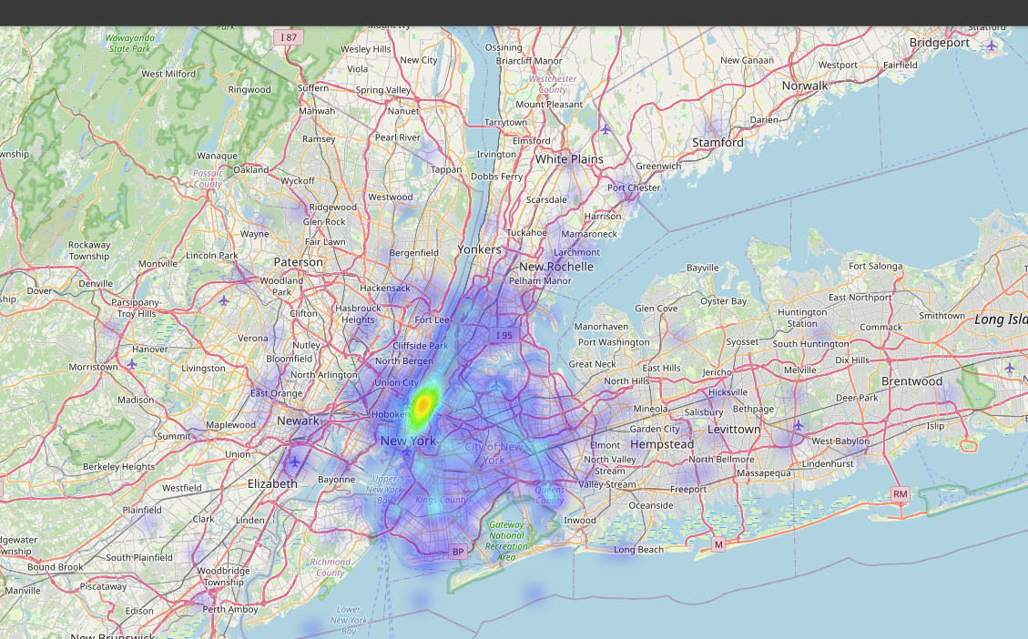
Heatmap of pickup locations in NYC

Slide 22
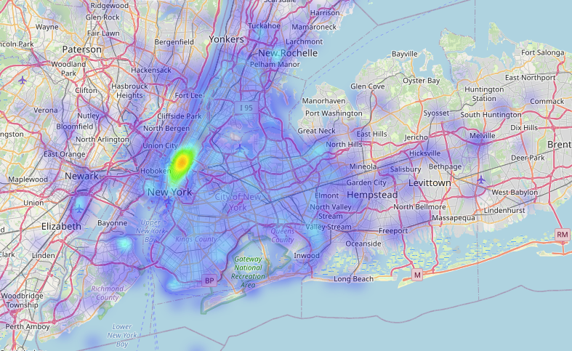
Heatmap of dropoff locations in NYC

Slide 23
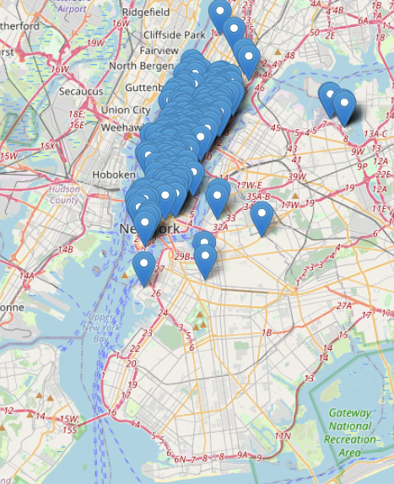
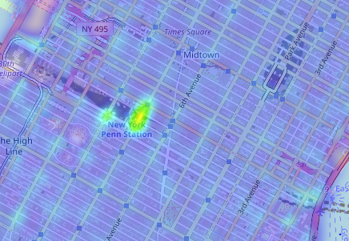
Pickup markers & hottest place for pickup

Slide 24
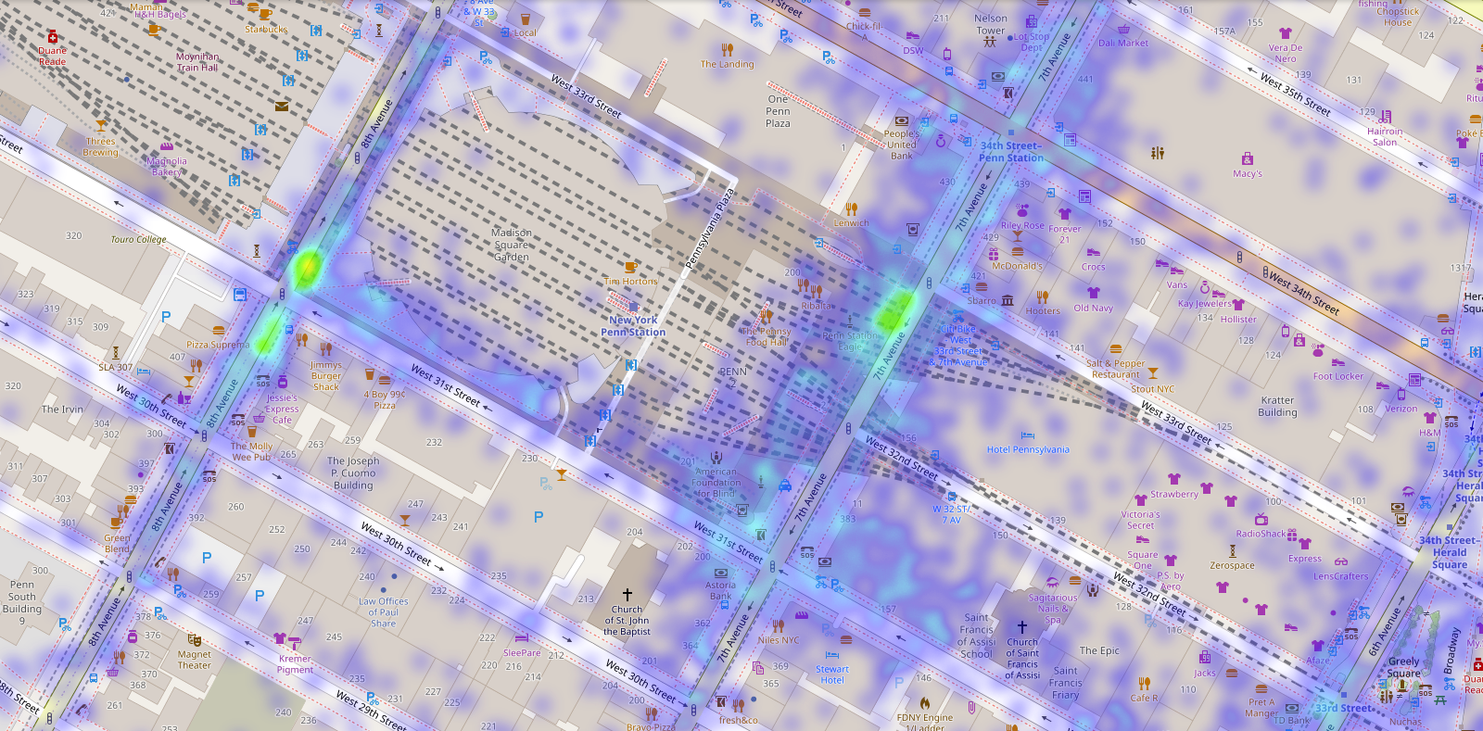
Most pickup Locations in NYC
pickup location pickups are generally from NYC penn station (outstation)mainly on 7th & 8th Avenue street & intersection between 8th avenue & west 31st Street, for 250K samples of our data

Slide 25
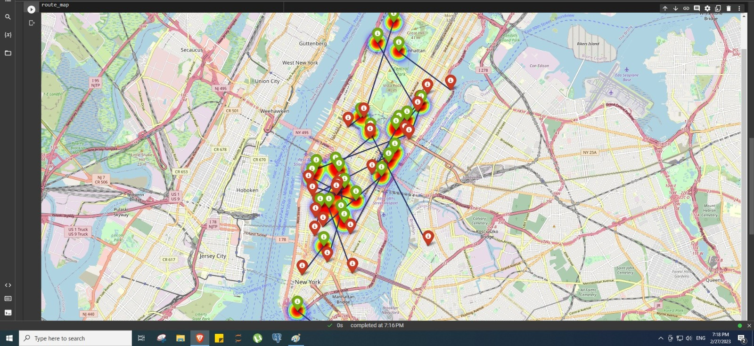
Route Map
Green Marker : Pickup Location
Red Marker : Dropoff Location

Slide 26
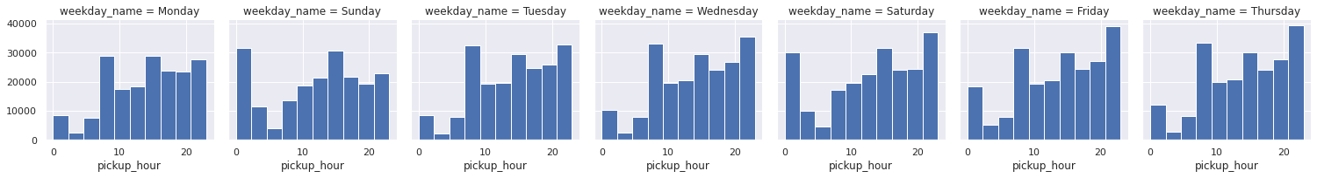
Pickup Hours
Taxi pickups increased in the late night hours over the weekend possibly due to more outstation rides or for the late night leisure's nearby activities.
Early morning pickups i.e. before 5 AM have increased over the weekend in comparison to the office hours pickups i.e. after 7 AM which have decreased due to obvious reasons.
Taxi pickups seems to be consistent across the week at 15 Hours i.e. at 3 PM.

Slide 27
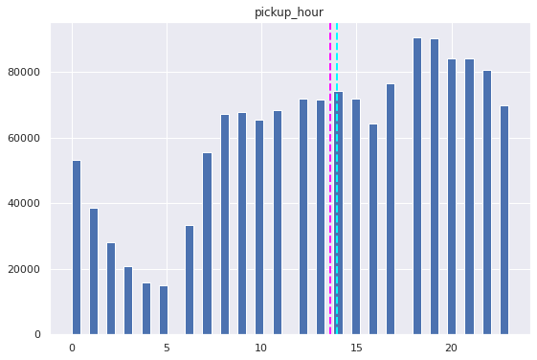
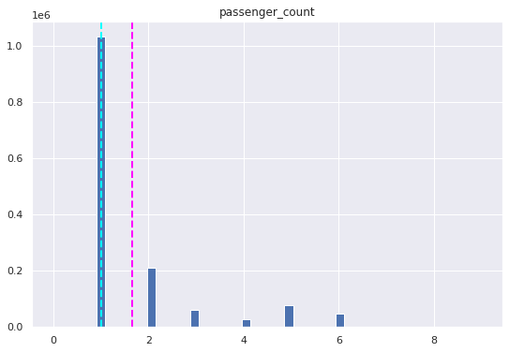
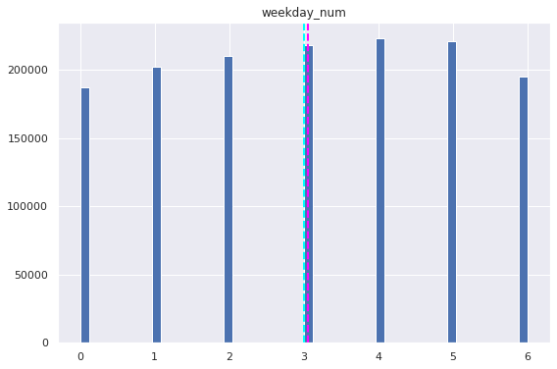
Bar Plots

Slide 28
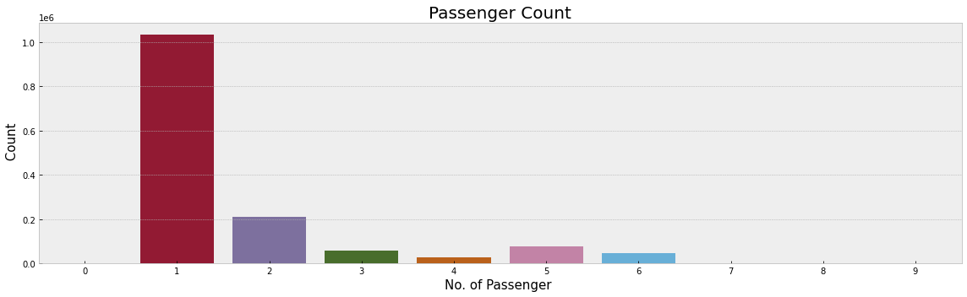
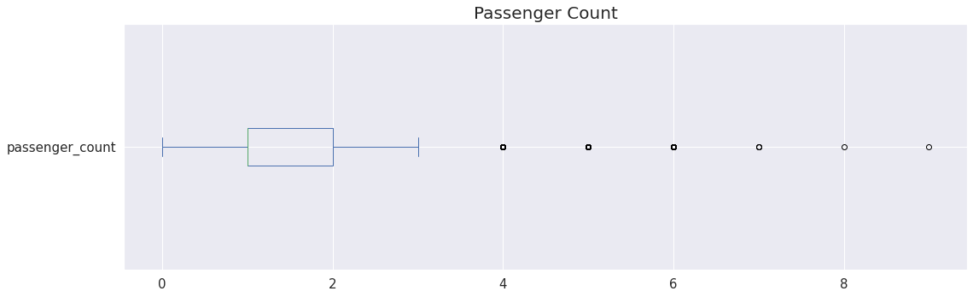
Passenger Counts
Number of passengers per trip
There are some trips with 0 passenger count.
Few trips consisted of even 6, 7, 8 or 9
passengers. Clear outliers and pointers to
data inconsistency
Most of trip consist of passenger
either 1 or 2.

Slide 29
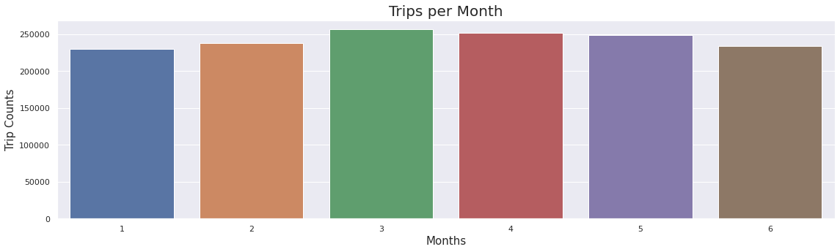
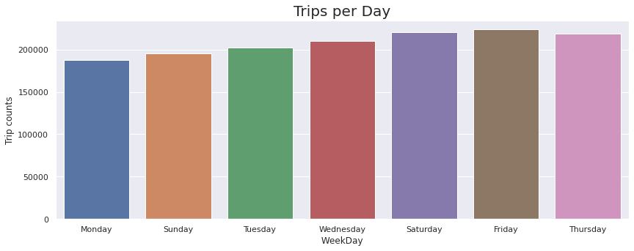
Number of trips
Number of trip per month
Most number of trips are in march and then
after April and may
Number of trip per day of week
Here we can see an increasing trend of taxi
pickups starting from Monday till Friday.
The trend starts declining from Saturday till
Monday which is normal where some office
going people likes to stay at home for rest
on the weekends.

Slide 30
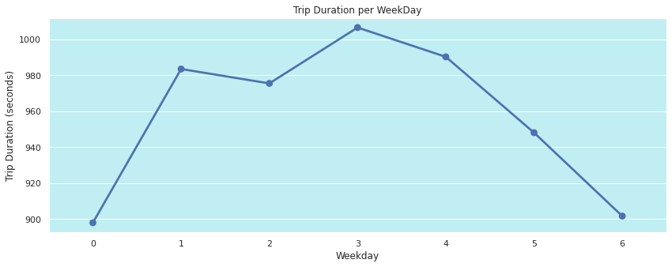
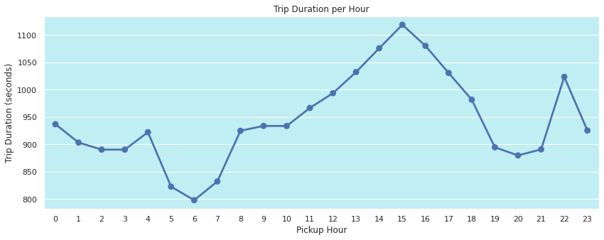
Trip Duration
We can see that trip duration is almost equally distributed across the week on a scale of 0-1000 minutes with minimal difference in the duration times. Also, it is observed that trip duration on thursday is longest among all days
Average trip duration is lowest at 6 AM when there is minimal traffic on the roads.
Average trip duration is generally highest around 3 PM during the busy streets.
Trip duration on an average is similar during early morning hours i.e. before 6 AM & late evening hours i.e. after 6 PM

Slide 31
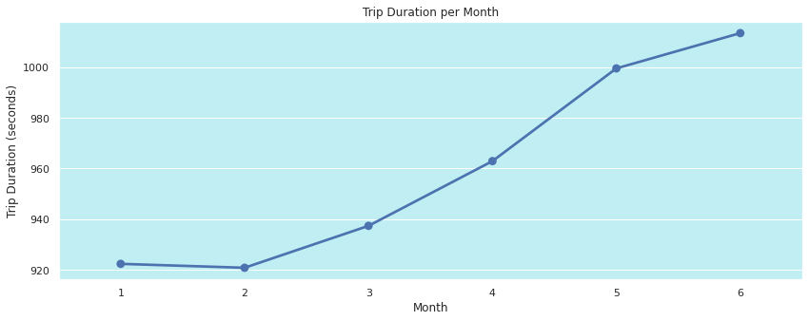
Trip Duration
There is an increasing linear relationship between the months and the average value of the duration of trips.

Slide 32
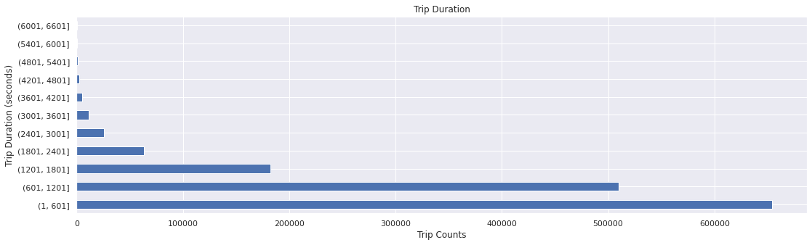
Trip Duration in 10 minute slab
Some trip durations are over 100000 seconds which are clear outliers and should be removed.
There are some durations with as low as 1 second. which points towards trips with 0 km distance.
Major trip durations took between 10-20 mins to complete.
Mean and mode are not same which shows that trip duration distribution is skewed towards right

Slide 33
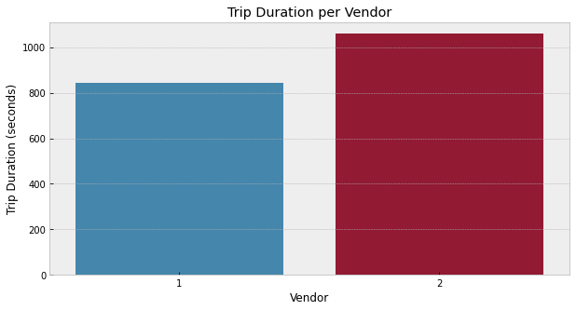
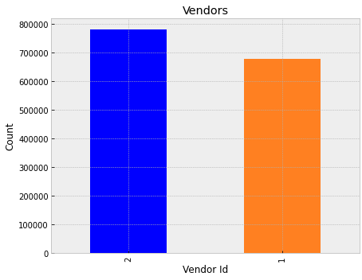
All about Vendor
Vendor 2 takes the crown. Average trip duration for vendor 2 is higher than vendor 1 by a quite low margin
Both the venders share almost equal amount of trips, the difference is quite low between two venders
But Vendor 2 is evidently more famous among the population as per the above graphs

Slide 34
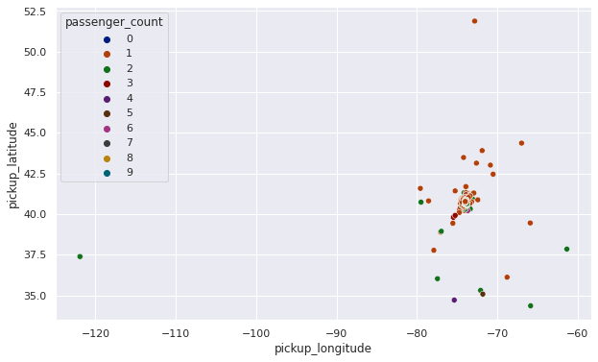
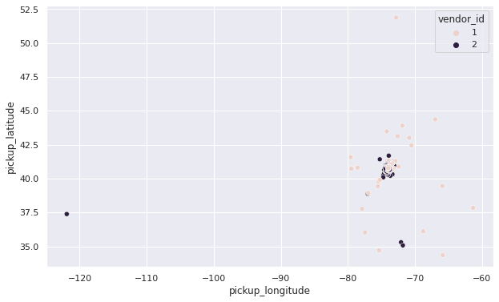
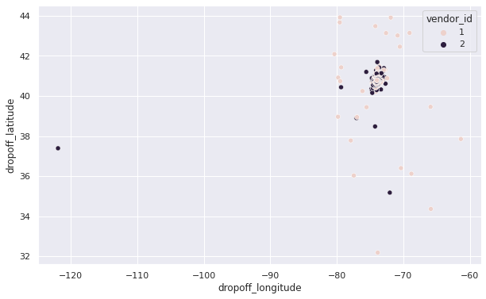
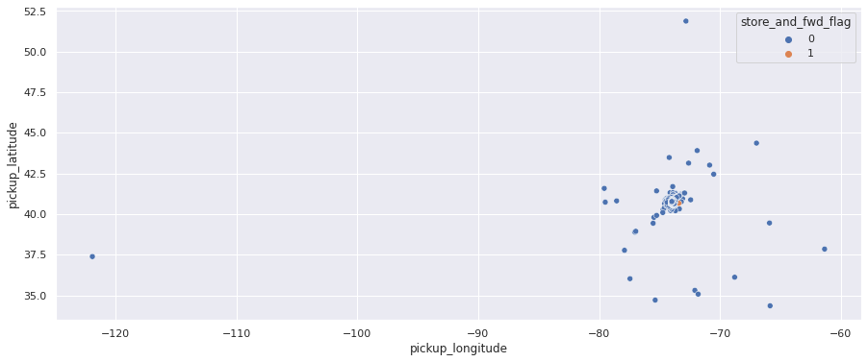
Scatter Plots

Slide 35
Hypothesis Testing
6
Using different scenarios and assumptions validates claim about a population based on sample data.

Slide 36
Hypothesis Test 1
STATEMENT There is a significant difference in the trip duration between trips with a single passenger and trips with multiple passengers.
Null hypothesis: There is no significant difference in the trip duration between trips with a single passenger and trips with multiple passengers.
Alternative hypothesis: There is a significant difference in the trip duration between trips with a single passenger and trips with multiple passengers.

Slide 37
Result
The p-value of 9.89e-28 signifies that the probability of observing such extreme differences in trip duration between single passenger trips and multi-passenger trips by chance is very low. Therefore, we can reject the null hypothesis and conclude that there is a significant difference in trip duration between these two groups.

Slide 38
Hypothesis Test 2
STATEMENT Trips with a higher distance have a longer duration
Null hypothesis: The distance of the trip does not significantly affect the duration of the trip.
Alternative hypothesis: The distance of the trip significantly affects the duration of the trip.

Slide 39
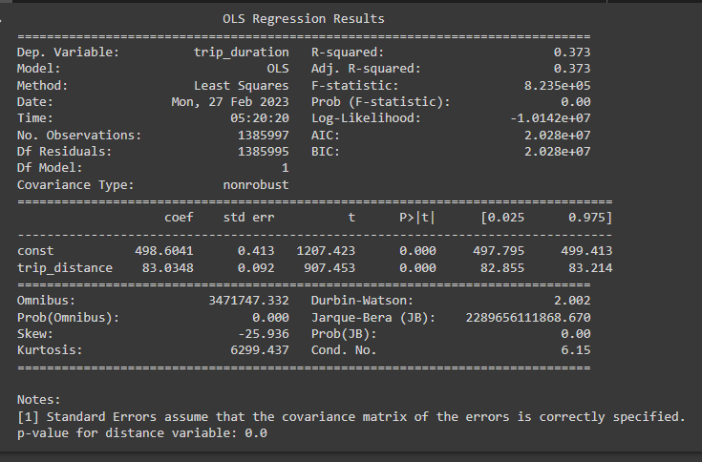
Result

Slide 40
Result
P_value of distance variable 0.0 indicates that the probability of obtaining the observed sample result assuming that null hypothesis is true is extremely small (essentially zero).
Therefore , we reject Null Hypothesis and conclude that there is a significant relationship between the two variables.

Slide 41
Hypothesis Test 3
STATEMENT:
Trips during weekdays have a longer duration compared to weekends
Null hypothesis: The distance of the trip does not significantly affect the duration of the trip.
Alternative hypothesis: The distance of the trip significantly affects the duration of the trip.

Slide 42
Result
The t-statistic of 3.9008 indicates that the difference between the means of the two groups (weekday and weekend trip durations) is 3.9008 times greater than the standard error of the difference between the means.
The p-value of 9.586970042130944e-05 (0.00009587) is less than the commonly used significance level of 0.05, which suggests strong evidence against the null hypothesis.
Therefore, we reject Null hypothesis and conclude that there is a statistically significant difference between the means of weekday and weekend trip durations

Slide 43
Data Prepocessing & Feature Engineering
7
Handling Outliers , Feature manipulation and Selection

Slide 44
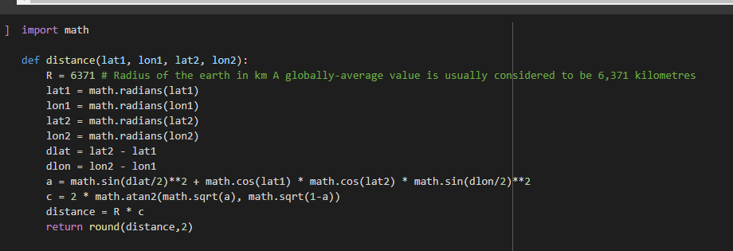
Feature Manipulation
We use this distance function to calculate distance between two locations

Slide 45
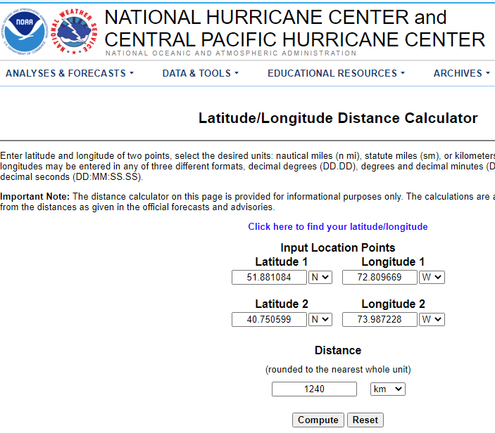
Feature Manipulation
We use location base data that is latitude and longitude in our data and Find the distance between pickup and drop-off location
Also we cross-validate our answer with National Hurricane center and central pacific hurricane center website
We take one sample from our data and store the value into this website. The result is same

Slide 46
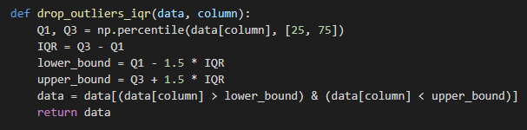
Handling Outliers
We use this function to drop the outliers using Inter quartile Range of 25 and 75 Percentile

Slide 47
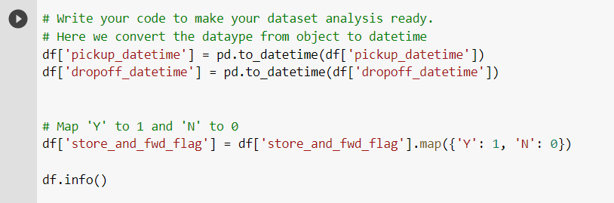
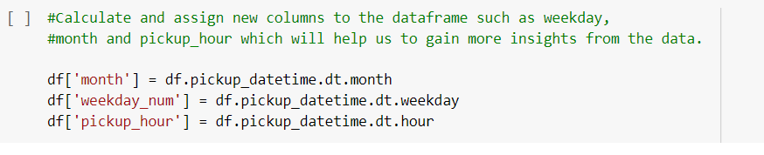
Feature Engineering
The Date and time columns in the Dataset has whole lot story to tell, we have to fetch them as separate columns. We do not have to fetch pickup and dropoff time both, as they may lead to strong positive correlation in the respective fetched features. Further we can use these columns for Analysis.

Slide 48
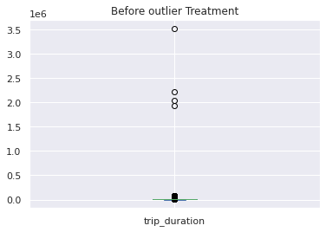
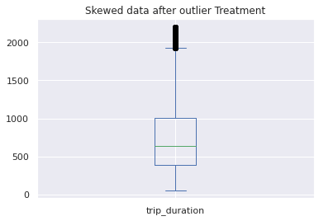
Outliers Treatment
Trip Duration Before And After Outlier Treatment

Slide 49
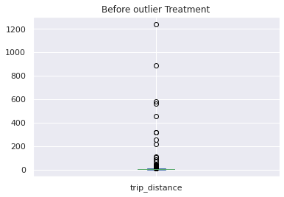
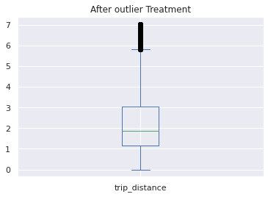
Outliers Treatment
Trip Distance Before And After Outlier Treatment

Slide 50
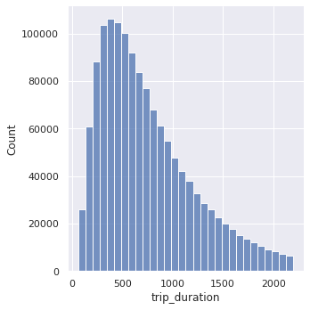
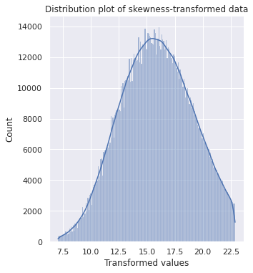
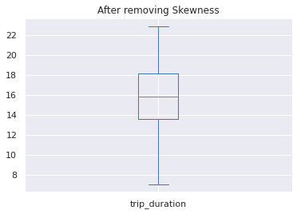
Dealing with Skewness
We use box-cox transformation to remove skewness but the thing is it reduces the trip duration to 7 – 24 from 0 to 2200, which causing large amount of data loss. Hence we are keeping the data as it is.

Slide 51
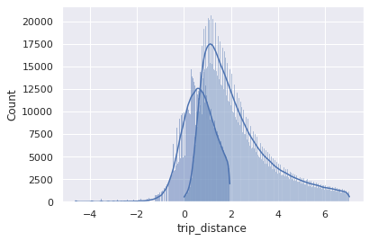
Dealing with Skewness
In this chart of trip distance count if we apply any sort of Transformation it leads to add negative values in our data

Slide 52
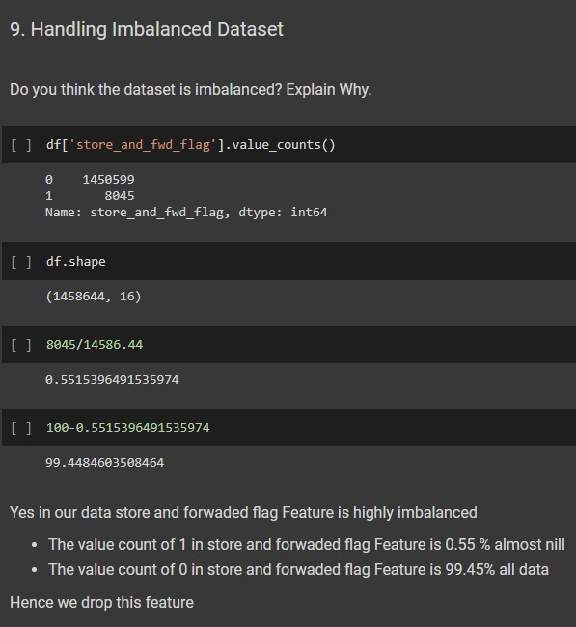
Imbalanced Data
Handling Imbalance data
In our data set the feature Store and fwd flag
The value count of 1 Feature is 0.55 % almost nil
The value count of 0 Feature is 99.45% all data
Hence we drop this feature

Slide 53
Feature Selection
passenger_count
pickup_longitude
pickup_latitude
dropoff_longitude
dropoff_latitude,
month
weekday_num
pickup_hour
trip_distance

Slide 54
Data Splitting
We have split the data into 80:20 ratio
Where 80 % data is for training and 20 % for test

Slide 55
Model Implementation
8
Implementation of different Machine Learning models

Slide 56
Model 1 : Linear Regression
Root Mean square Error: 291.67
Mean Absolute Error : 217.92
R2 : 0.48
Adjusted R2 : 0.48

Slide 57
Model 2 : Ridge
Root Mean square Error: 291.67
Mean Absolute Error : 217.92
R2 : 0.48
Adjusted R2 : 0.48

Slide 58
Model 3 : Lasso
Root Mean square Error: 293.45
Mean Absolute Error : 219.75
R2 : 0.47
Adjusted R2 : 0.47

Slide 59
Model 4 : Random Forest Regressor
Root Mean square Error: 213.28
Mean Absolute Error : 151.79
R2 : 0.72
Adjusted R2 : 0.72

Slide 60
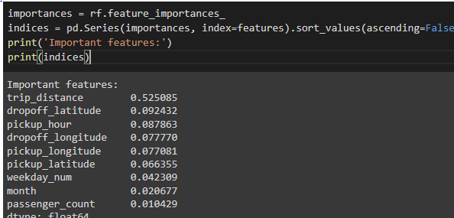
Most Important Feature
The importance of each feature is then normalized such that the sum of all feature importance's is equal to 1.0. Therefore, a higher feature importance value indicates that the feature is more important for the model's prediction.
In our case Most important feature is trip distance almost 52%

Slide 61
Best Model
From Above four Model we have chosen Random Forest Regressor Because
It reduces RMSE from 291.67 to 213.228
Reduces MAE from 217.92 to 151.78
Improves R2 from 0.48 to R2 score: 0.7208182963366805
Improve Adjusted r2 from 0.48 to 0.7208163191991594

Slide 62
Future Work
9
Future directions for improving taxi trip time prediction

Slide 63
Future Work
Incorporating more data
Taxi trip time prediction models can be improved by incorporating additional data sources, such as weather conditions, traffic patterns, and events happening in the city. This additional data can help the model better understand the factors that impact trip times.
Using advanced machine learning techniques
Advanced machine learning techniques, such as deep learning and ensemble learning, can be applied to taxi trip time prediction. These techniques can help capture complex patterns in the data that may be difficult to detect using traditional modeling approaches.
Developing real-time prediction models
Real-time prediction models can help provide more accurate estimates of trip times as conditions change. These models can be used to update taxi driver and passenger apps in real-time, providing more accurate and up-to-date information on trip times.
Improving the accuracy of pick-up and drop-off locations
Accurately predicting pick-up and drop-off locations can help improve the accuracy of trip time predictions. This can be accomplished through improved geocoding techniques or the use of more accurate location data.
Incorporating user feedback
User feedback can help improve the accuracy of trip time predictions over time. This feedback can be used to refine the model and identify areas where improvements can be made.

Slide 64
Conclusion
10
Final conclusion of our project

Slide 65
Conclusion
In conclusion, predicting taxi trip time accurately is an important task for optimizing transportation services in NYC. There have been many efforts to improve the accuracy of trip time predictions, including the use of advanced machine learning techniques, incorporating additional data sources, developing real-time prediction models, improving location accuracy, and incorporating user feedback.
Improving the accuracy of taxi trip time predictions has the potential to provide significant benefits:
As such, it is an important area of research and development that will likely continue to receive attention and investment in the years to come.
For transportation services in NYC
Including reducing wait times for passengers
Optimizing driver routes and
Improving overall transportation efficiency

Slide 66
Advantages TRIO
Transpotation
For transportation services in NYC
Reducing
Reducing wait times for passengers and increasing work efficiency
T
R
Improving overall transportation efficiency
Improving
Optimizing driver routes
Optimizing
I
o

Slide 67

THANKS!
Any questions?
You can find me at:
@MaratheVinayak
https://github.com/v1git12

